Slide 1
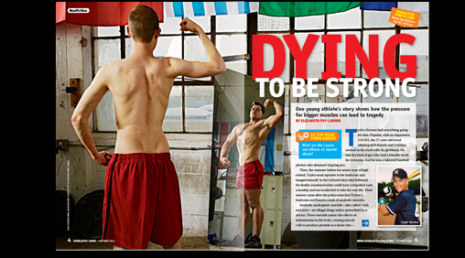
Dying to be strong
vocabulary

Slide 2
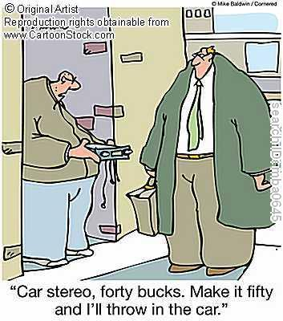
black market
9Noun) Black market refers to the buying and selling of products in a way that breaks rules or laws. In other words, the black market is illegal trade.
There is not an actual, physical black market—the term does not refer to a place where you can go. Rather, it describes a way of buying and selling things.
Products such as illegal drugs, guns, and stolen goods are sold on the black market. Legal products are also sold on the black market. If a legal product is sold in an illegal way, for example, if the seller charges more for something than the government allows), it is sold on the black market.

Slide 3
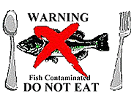
contaminant
(noun)A substance that contaminates, or makes something impure or unfit for use by mixing it with something harmful, drty, or unpleasant. For example, a poisonous chemical poured into a river is a contaminant.

Slide 4
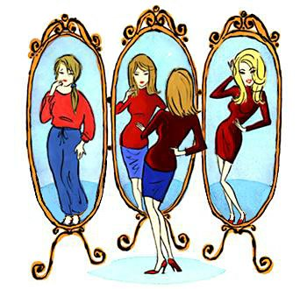
dysmorphic
(Adjective) Badly formed or shaped; having an ugly shape

Slide 5
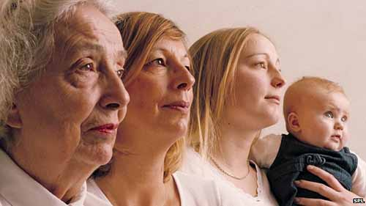
genetics
(Noun) Genetics can refer to the science of how traits are passed from parents to children. These traits include aspects of how we look (like eye color and height) and aspects of our personalities (like how shy we are). The traits are passed on through tiny parts of our cells called genes.
Genetics can also refer to the passing down of the traits themselves. Example: We asked Susan the secret to her great skin. She said it’s genetics—her whole family has great skin.

Slide 6
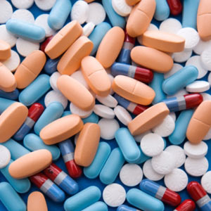
Performance-enhancing drugs
Performance-enhancing drugs are drugs that some athletes take to perform better at their sport.
(Performance is often used to describe a musical, drama, or other show presented for an audience. perform can simply mean “carry out” or “do”)

Slide 7
protein
(Noun) Proteins are molecules made from tiny building blocks called amino acids. Proteins are a part of every cell, tissue, and organ in our bodies and they are constantly being broken down and replaced. Their functions include healing wounds, fighting infection, and building muscle.
Protein is also an important part of our diets. Foods high in protein include meat, fish, eggs, nuts, seeds, legumes such as black beans and lentils, and dairy products.

Slide 8
regulate
(Verb) to control or manage. Example: The government regulates the safety and labeling of food. 2. to adjust or to keep at some standard. Example: We need to regulate the temperature in this building. One day it’s hot, the next day it’s freezing!

Slide 9
Testosterone
(Noun) Testosterone is a type of hormone that your body makes which tells your cells what to do. They help keep your body running smoothly. For example, hormones control when you feel hungry, when and how you sleep, and your body temperature. Hormones play an important role in growth, too. The changes that happen to the body during puberty are due to hormones.
Both girls and boys have testosterone, but boys have a lot more. During puberty, the level of testosterone in boys’ bodies rises, which causes changes like growing facial hair and deepening of the voice. Testosterone also helps build muscles.

